Slide 1

Data Science & analytics
Erik van der Hoeven

Slide 2
DATA IS THE NEW OIL
http://datadriven.tv/data-new-oil-welcome-car-talk/
https://www.aam-us.org/2014/05/01/a-geyser-of-information-tapping-the-big-data-oil-boom/

Slide 3
The Data Scientist

Slide 4
How the force works: turn data into wisdom
Tools
Business Understanding
Data Understanding
Analyzing & presentation
Deployment
Data Preperation
Statistics & Modeling
Evaluation
Modeling

Slide 5
Business Understanding
What do you want to investigate?
Hypothesis
What is the profit
SMART
Target variable

Slide 6
Tooling: Choice your lightsaber
Python
R
Excel
Character
Character
Character
Python is one of the most popular general purpose programming languages for data science
R is an open source programming language and an offshoot of a programming language called S
Is a spreedsheet program from Microsoft with statistical function in it. It is not a Data Science tool

Slide 7
Data Understanding
What is the quality of your data?
Distribution
Outliners
Can I explain the outliners?
Can I improve it?
Inter and extrapolation (depends on the volume)
Risks
Type of data
Nominal
Ordinal
Interval
Hierarchy
How does the data fit with the Business Question?
Visualize your information

Slide 8
Data Presentation Make it self explainable
Titel and Legenda
Try not to present all data in one graph
People get distracted
And it is not readable
Use the right graph to create the expected insight(s):
For example:
scatterplots -> correlations
Boxplots -> distribution and deviation
Barcharts -> progress and distribution
Pivot Tables -> Showing numbers

Slide 9
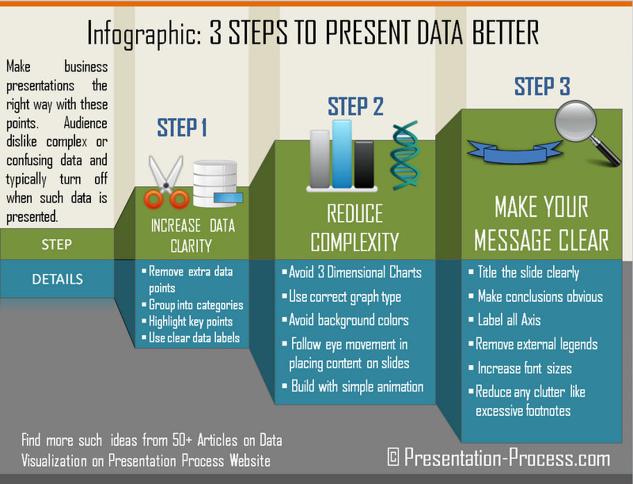
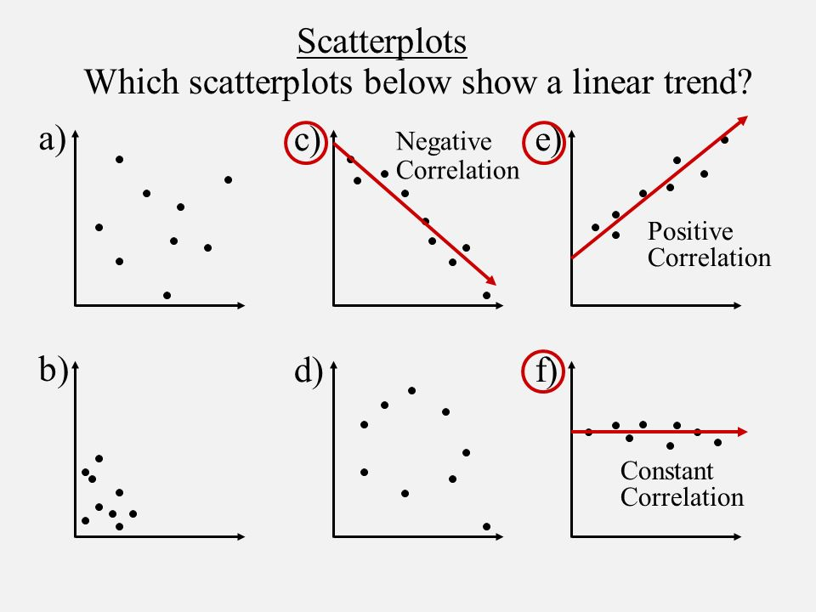
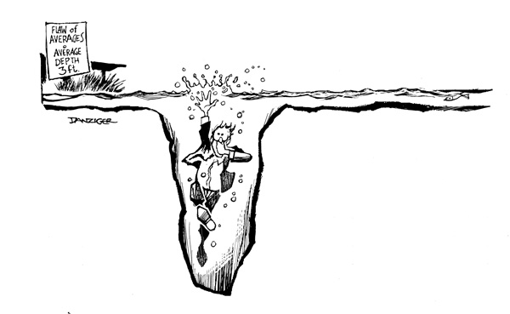
Data preperation
Distribute the measures over the (x) as
example:
Time(ordinal) -> use a scatterplot
Group and convert ordinal measures to nominal measures if there are not many measures in that category. Example ( age : 1 – 5 , 6 - 10)
Use a standard deviation
Use correlation & entropy

Slide 10
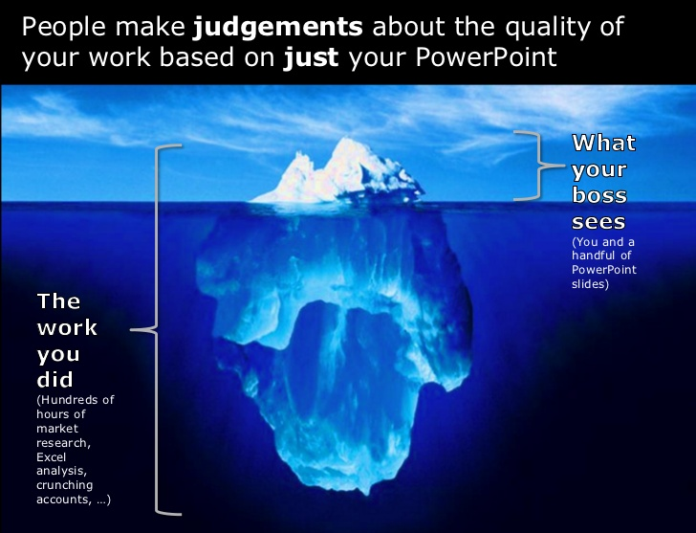
Why is good data presentation important?

Slide 11
DATA MODELING: FIT FOR PURPOSE
Target variable
Yes
No
Supervised learning
Unsupervised learning
Continues
Categorical
Clustering
Association
Regression
Classification

Slide 12
EVALUATION
Actual values
Postitive(1) | Negative(0)
TP | FP
FN | TN
Positive(1)
Actual values
Negative(0)

Slide 13
Practicing with our lightsabre
This is a high speed workshop to show what is possible
The exercise focusses on data understanding
Python
Data Science Library
Data Science Library
Note:
On git https://github.com/ErikHoeven/DataScienceLessons you find instructions to download, install and configure the tools
On git you also find the examples you later need for the exercise

Slide 14
Python Glossary
Command | Explenation | Example
import | Import library which fits to a specific purpose | import pandas as pd
pandas | Library fit for data structures and transformation
variable | A name which contain a placeholder for a specific purpose. With the = following with a value will assign a value to the variable. | Fruit = “apple” Fruit = 1
Calling the variable | Repeating the variable will show the current value of the variable | Fruit = 1 Fruit -> shows 1 Fruit = “apple” Fruit -> shows Apple

Slide 15
Serie and DataFrame

Slide 16
Workshop
Creating datasets
Visualization
Wrap it all up(dataset, visualization)

Slide 17
Learn more
Book: Data Science for Business
Book: McKay Information Theory
Coursera: https://www.coursera.org/specializations/jhu-data-science
Udemy: https://www.udemy.com/course/python-for-data-science-and-machine-learning-bootcamp/
Datasets & datascience competitions (www.kaggle.com)

Slide 18
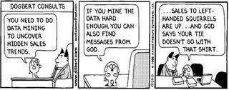
Thanks for listening

